Slide 1
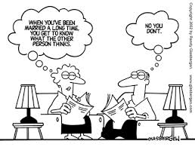
Essential Characteristics of a
Healthy Marriage

Slide 2

Take a moment to stop & think
What is love?
What makes for a good marriage?
How is it that marriages succeed or fail?

Slide 3
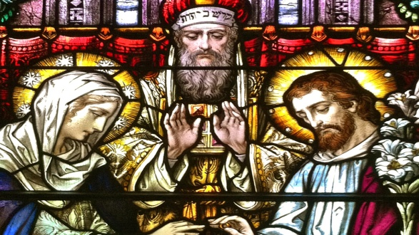
A theology of marriage
“TO BE LOVED BUT NOT KNOWN IS COMFORTING BUT
SUPERFICIAL. TO BE KNOWN AND NOT LOVED IS OUR
GREATEST FEAR. BUT TO BE FULLY KNOWN AND TRULY
LOVED IS, WELL, A LOT LIKE BEING LOVED BY GOD. IT
IS WHAT WE NEED MORE THAN ANYTHING. IT
LIBERATES US FROM PRETENSE, HUMBLES US OUT OF
OUR SELF-RIGHTEOUSNESS, AND FORTIFIES US FOR ANY
DIFFICULTY LIFE CAN THROW AT US.”
― TIMOTHY KELLER, THE MEANING OF MARRIAGE:
FINDING HAPPINESS IN YOUR MOST PROFOUND
RELATIONSHIP

Slide 4

“the love lab”
From a 15 minute observation of the couple, they could predict marital dissolution with 94% accuracy.
Studied over 3000 couples for a twenty year period
4 primary longitudinal studies
Prediction about marital dissolution was based on 3 measurement domains
  Interactions of the couple
  Perception of each partner
  Physiology of each partner
  (Gottman, 2008)

Slide 5
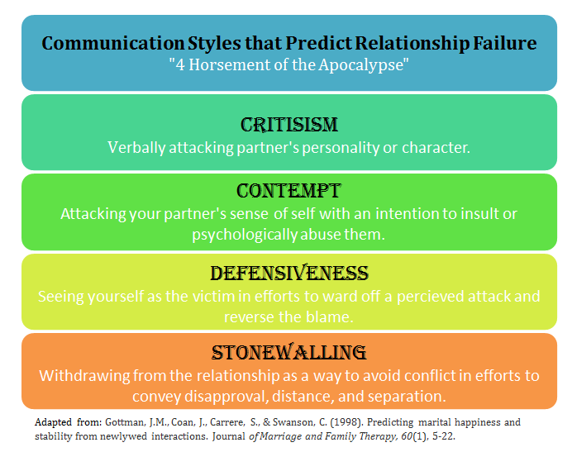
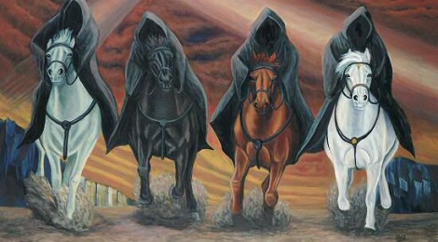
Relationships in Trouble

Slide 6
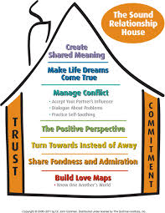
Healthy relationships according to the gottman’s

Slide 7
God’s searching love in psalm 139
O Lord, you have searched me and known me! ² You know when I sit down and when I rise up; you discern my thoughts from afar. ³ You search out my path and my lying down and are acquainted with all my ways. ⁴ Even before a word is on my tongue, behold, O Lord, you know it altogether. ⁵ You hem me in, behind and before, and lay your hand upon me. ⁶ Such knowledge is too wonderful for me; it is high; I cannot attain it. ⁷ Where shall I go from your Spirit? Or where shall I flee from your presence? ⁸ If I ascend to heaven, you are there! If I make my bed in Sheol, you are there! ⁹ If I take the wings of the morning and dwell in the uttermost parts of the sea, ¹⁰ even there your hand shall lead me, and your right hand shall hold me. ¹¹ If I say, “Surely the darkness shall cover me, and the light about me be night,” ¹² even the darkness is not dark to you; the night is bright as the day, for darkness is as light with you.¹³ For you formed my inward parts; you knitted me together in my mother's womb. ¹⁴ I praise you, for I am fearfully and wonderfully made. Wonderful are your works; my soul knows it very well. ¹⁵ My frame was not hidden from you, when I was being made in secret, intricately woven in the depths of the earth. ¹⁶ Your eyes saw my unformed substance; in your book were written, every one of them, the days that were formed for me, when as yet there was none of them. ¹⁷ How precious to me are your thoughts, O God! How vast is the sum of them! ¹⁸ If I would count them, they are more than the sand. I awake, and I am still with you….²³ Search me, O God, and know my heart! Try me and know my thoughts! ²⁴ And see if there be any grievous way in me, and lead me in the way everlasting!

Slide 8
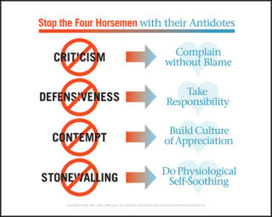
Disarming the 4 horsemen:
The marital antidote

Slide 9
Experiential exercise
CREATING A WISH LIST:
Practice being the speaker
and the listener

